Slide 1
Mining Query Subtopics from Search Log Data
Date : 2012/12/06
Resource : SIGIR’12
Advisor : Dr. Jia-Ling Koh
Speaker : I-Chih Chiu
Notes:
從user過去搜尋過的歷史紀錄，來挖掘出跟query有關聯的subtopic

Slide 2
Outline
Introduction
Two Phenomena
Clustering Method
Experiments
Applications
Conclusion

Slide 3




Introduction
Understanding the search intent of users is essential for satisfying a user’s search needs.
The intents of a query
  Its search goals
  Semantic categories or topics
  Subtopics
Notes:
根據搜尋的目標，可以將query分成三類 informational, navigational, and transactional
利用已定義好的categories將query進行分類
Multiple senses and multiple facets

Slide 4
Motivation
Most queries are ambiguous or multifaceted.
Ambiguous: “Harry Shum”
  American actor
  A vice president of Microsoft
  Other person
Multifaceted: “Xbox”
  Online game
  Homepage
  Marketplace
Notes:
apple

Slide 5
Goal
They aim to automatically mine the major subtopics (senses and facets) of queries from the search log data.
1
2
Two Phenomena
“one subtopic per search” (OSS)
“subtopic clarification by additional keyword”(SCAK)
Clustering Method
Preprocessing
Clustering
Postprocessing

Slide 6
Outline
Introduction
Two Phenomena
  One Subtopic per Search
  Subtopic Clarification by Additional Keyword
Clustering Method
Experiments
Applications
Conclusion
Notes:
這兩個現象是否能夠有效的幫助query找到與query相關的subtopic
所以分別描述這兩個現象，並且透過數據來證實他們的確是有幫助的

Slide 7
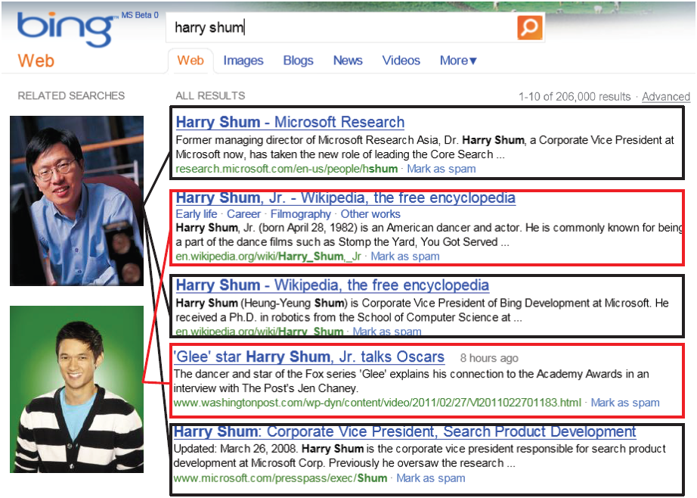
One Subtopic per Search
Each group of URLs actually corresponds to one sense
URL 1
URL 2
URL 3
URL 4
URL 5
Notes:
查詢所點擊的URL往往會代表著相同的subtopic

Slide 8
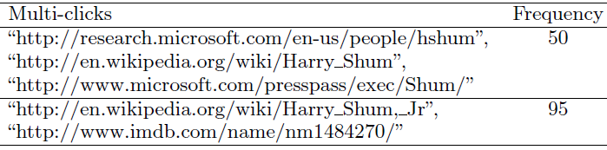
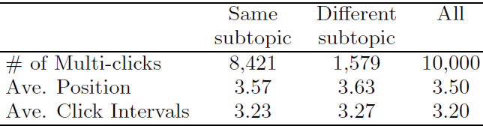
One Subtopic per Search
Rational users and not randomly click on search results.
Usually have one single subtopic in mind.
Multi-clicks in search logs of ‘harry shum’
Accuracy of rule v.s. click position
Notes:
不隨機點選查詢結果
對於特定的查詢，user通常只會有一個subtopic
User可能會不小心點到其他屬於不同group的URL，但是這樣的情況是很稀少的
因為使用者在找尋特定的人只會點選與其相關的資訊，會忽略掉其他不相關的人名

Slide 9

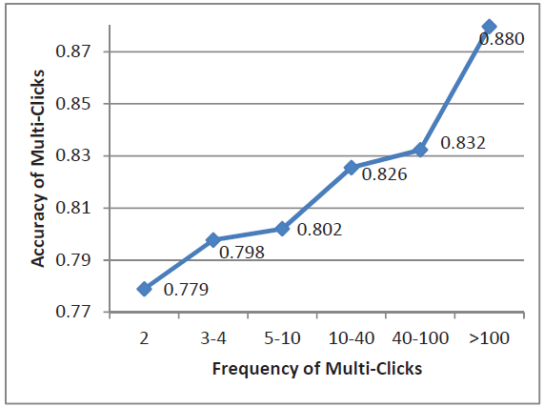
One Subtopic per Search
Accuracy of rule v.s. number of clicks (User)
Accuracy of rule v.s. frequency (Group)
Conclusion :
The phenomenon of one subtopic per search can help query subtopic mining for head queries.

Slide 10

Subtopic Clarification by Additional Keyword
Search users are rational.
Add additional keywords to specify the subtopics
Search logs of ‘harry shum’ ignoring click frequency
Distribution of Query Types (randomly select 1000 queries)

Slide 11
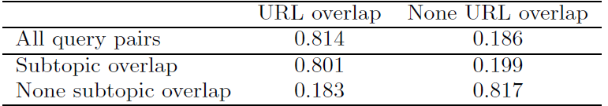
Subtopic Clarification by Additional Keyword
Relation of subtopic overlap and URL overlap between query and expanded query pair
  Subtopic overlap
  If subtopics of an expanded query are contained in subtopics of the original query
  URL overlap
  Two queries share identical clicked URLs
None URL and None subtopic
  Ex : ‘beijing’ and ‘beijing duck’, ‘fast’ and ‘fast food’

Slide 12
Outline
Introduction
Two Phenomena
Clustering Method
Experiments
Applications
Conclusion

Slide 13
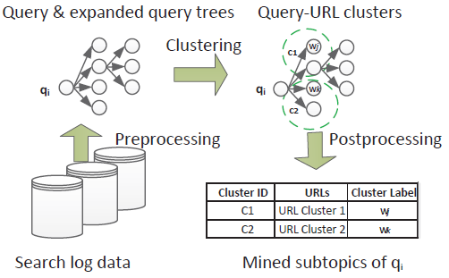
Clustering Method
A clustering method to mine subtopics of queries leverage the two phenomena and search log data.
The flow of clustering method

Slide 14
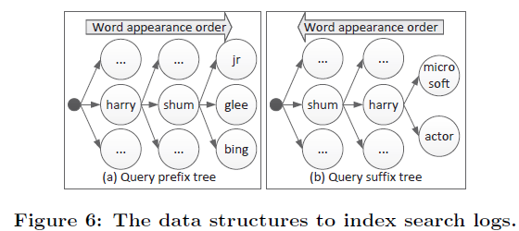
Preprocessing(Indexing)
An index consists of a prefix tree and a suffix tree
  Prefix : query ‘Q’ , expanded queries ‘Q+W’
  Suffix : query ‘Q’ , expanded queries ‘W+Q’
They can easily find the expanded queries of any query
Notes:
父點與子點

Slide 15
Preprocessing(Pruning)
If a query ‘Q’ doesn’t have URL overlap with its expanded queries, then remove the false expanded queries by using a heuristic rule.
For example
  ‘fast food’ and ‘fast’
  ‘hot dog’ and ‘dog’
Q
Q+W
W+Q
A child node will be pruned.
Notes:
heuristic rule : 非實徵的使用性評估，而依賴於專家根據某些已驗證過的經驗法則進行評估
即透過幾位專家根據一些通用的可用性原則和自己的經驗來發現評估一個問題

Slide 16


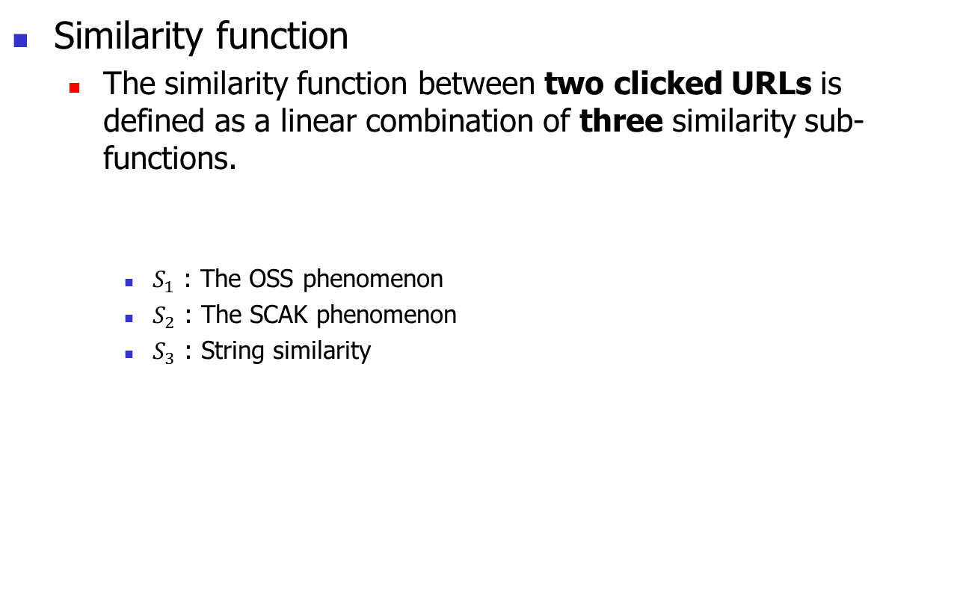

Clustering
Similarity function
  The similarity function between two clicked URLs is defined as a linear combination of three similarity sub-functions.
    $S_{1}$ : The OSS phenomenon
    $S_{2}$ : The SCAK phenomenon
    $S_{3}$ : String similarity
$$S\left(u_{i},u_{j}\right)=αS_{1}\left(u_{i},u_{j}\right)+βS_{2}\left(u_{i},u_{j}\right)+γS_{3}(u_{i},u_{j})$$
$$S_{3}:cosine similarity$$
Notes:
利用每一個query和它的expanded queries 點擊的URLs 處理cluster
因為所有的queries都在tree裡建好索引，所以cluster可以有效地遞迴執行

Slide 17
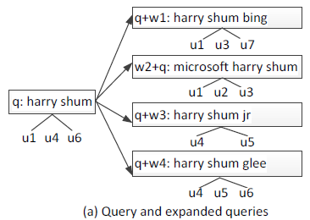
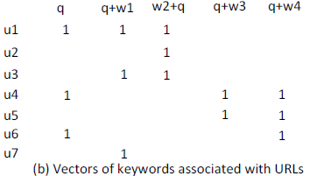
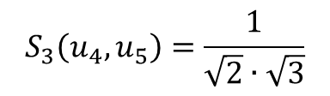
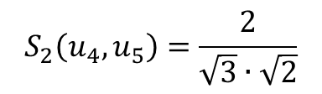
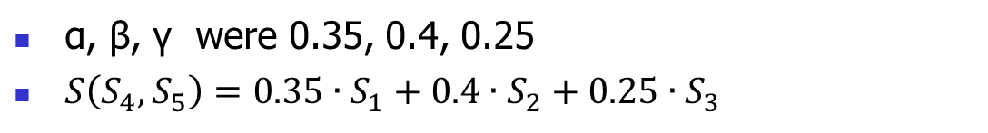
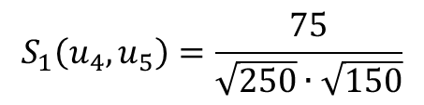
q1 q2 q3 q4 q5
10 0 30 0 5
20 5 15 5 0
0 0 5 15 20
15 0 0 5 0
$$S_{2}\left(u_{4},u_{5}\right)=\frac{2}{\sqrt{3}∙\sqrt{2}}$$
5 5 10 0 0
t1 t2 t3 t4 t5
0 5 15 5 10
0 10 0 20 15
1 0 0 1 0
1 0 1 1 0
$$S_{1}\left(u_{4},u_{5}\right)=\frac{75}{\sqrt{250}∙\sqrt{150}}$$
0 0 1 1 1
1 0 0 1 0
1 1 1 0 0
0 1 1 0 0
Ex : “http://en.wikipedia.org/wiki/Harry Shum”
Based on the slash symbols
Features : Baseline, URI Components, Length, etc.
Segment a URL into tokens
0 1 0 1 1
$$S_{3}\left(u_{4},u_{5}\right)=\frac{1}{\sqrt{2}∙\sqrt{3}}$$
α, β, γ were 0.35, 0.4, 0.25
$S\left(S_{4},S_{5}\right)=0.35∙S_{1}+0.4∙S_{2}+0.25∙S_{3}$

Slide 18
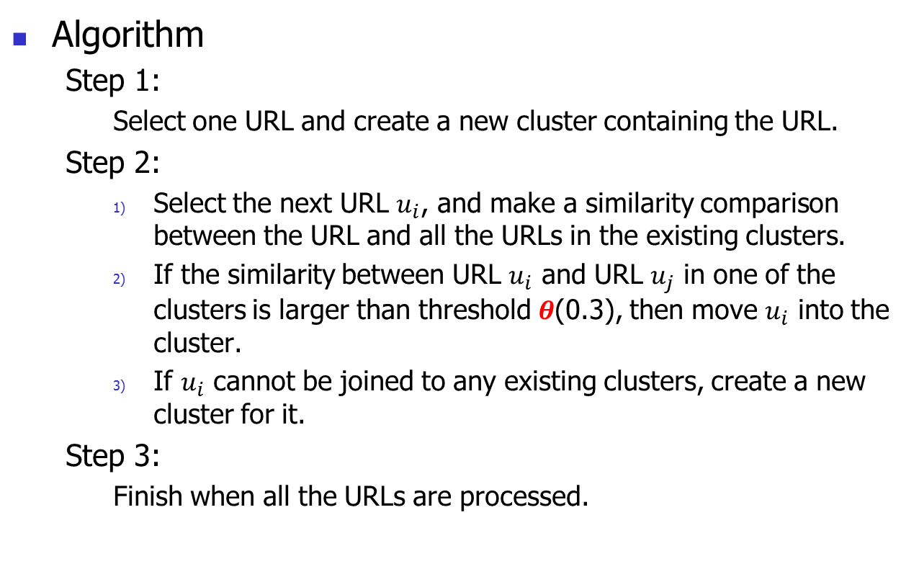
Clustering
Algorithm
  Step 1:
    Select one URL and create a new cluster containing the URL.
  Step 2:
    Select the next URL $u_{i}$, and make a similarity comparison between the URL and all the URLs in the existing clusters.
    If the similarity between URL $u_{i}$ and URL $u_{j}$ in one of the clusters is larger than threshold $θ$(0.3), then move $u_{i}$ into the cluster.
    If $u_{i}$ cannot be joined to any existing clusters, create a new cluster for it.
  Step 3:
    Finish when all the URLs are processed.

Slide 19
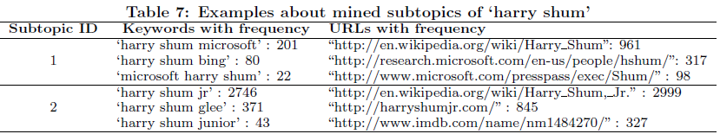
Postprocessing
The clusters which consist of only one URL are excluded.
Each cluster represents one subtopic of the query
Extract keywords from the expanded queries and assign them to the corresponding cluster as subtopic labels

Slide 20
Outline
Introduction
Two Phenomena
Clustering Method
Experiments on Accuracy
Applications
Conclusion

Slide 21
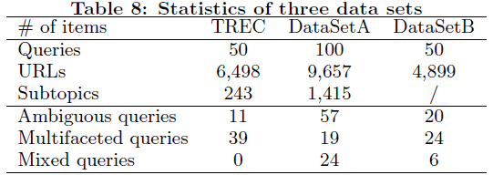
Experiments on Accuracy
Three data sets
Setting
  Parameter tuning : 1/3 of DataSetA
  Evaluation : 2/3 of DataSetA + the entire TREC
  After several rounds of tuning, α, β, γ, and θ were 0.35, 0.4, 0.25, and 0.3,respectively

Slide 22
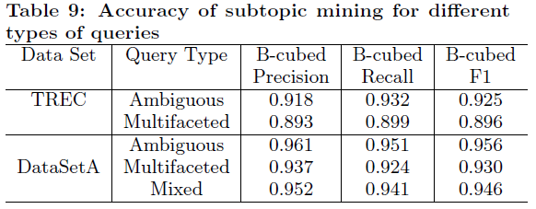
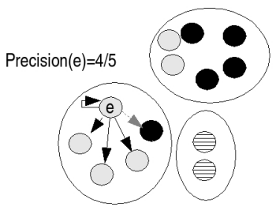
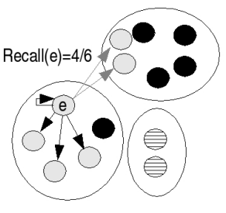
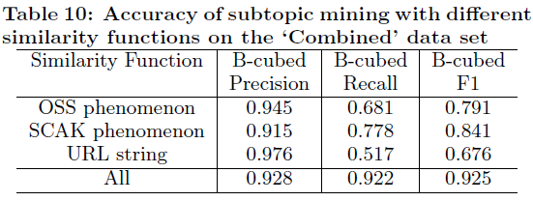
Experiments on Accuracy
Result
  Due to the sparseness of the available data.

Slide 23
Outline
Introduction
Two Phenomena
Clustering Method
Experiments
Applications
Conclusion

Slide 24




Search Result Clustering
Query
subtopic
mining
result
Offline:
database
Paper’s
method
subtopics
Online:
query
Seed clusters
not belong to any of
the mined subtopics
Cosine similarity
using the TFIDF of terms
in titles and snippets
the existing clusters or
create new clusters

Slide 25
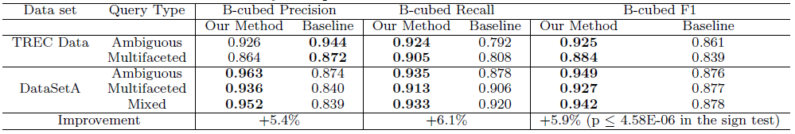
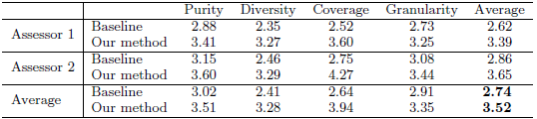
Search Result Clustering
Accuracy comparison between new method and baseline
Accuracy comparison from various perspectives
  The overall improvement is about 28%

Slide 26
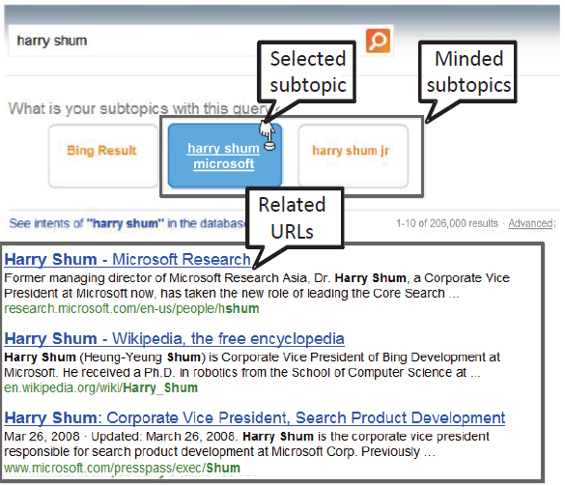

Search Result Re-Ranking
Example of search result re-ranking
Evaluation
the user to check the subtopics and click one of them
$$Δ=3.41−1.80−1=0.61$$
the average position of last clicked URLs belonging to the same subtopics
the average position of last clicked URLs

Slide 27
Outline
Introduction
Two Phenomena
Clustering Method
Experiments
Applications
Conclusion

Slide 28
Conclusion
Two phenomena of user search behavior can be used as signals to mine major senses and facets of ambiguous and multifaceted queries.
The clustering algorithm can effectively and efficiently mine query subtopics on the basis of the two phenomena.
To investigate the use of other features to further improve the accuracy.
Other existing algorithms can be applied as well.
They can be useful in other applications as well.

Slide 29
Thanks for your listening

